Slide 1
DATAFORGE 2026 · PATHWAY TRACK
Hatchling is All We Need
Demonstrations Are Weights
A frozen model that learns a new rule from its prompt, and what that costs.
demonstrations-are-weights.vercel.app
github.com/snivellus38/DataForge
Notes:
0:20 — Our name is a nod to "Attention Is All You Need". BDH, the Dragon Hatchling, is Pathway's post-Transformer architecture, and it is what we built on.
1

Slide 2
Two models, a three-page site, and every number traceable to a script.
WHAT WE WERE ASKED FOR
Pathway's brief: take one frontier idea and make it click . A falsiable claim, a variable the learner can change, a real section on BDH, and every number labelled by how far it can be trusted.
That is exactly why we picked: Test-Time Adaptation, optimization versus context. Fine-tuning changes the weights; we show a prompt doing the same job with the weights frozen, and measure the cost .
01
02
03
04
Train
Export
Run
Ship
PyTorch: a 131K cipher model, an 8M English→French model, and a Portuguese sibling for replication.
Activations, attention and the synapse graph G* are written out as data files.
The 131K model runs live in the browser, a hand-written JavaScript port matching PyTorch to 5.2 × 10⁻⁷. The 8M model is replayed from its real exported tensors.
Three web pages, a one-page LaTeX summary, 12 test gates with CI, MIT licence.
How every number in this talk is produced, end to end. Ours, the DataForge repository.
Evidence key for the rest of the talk:
Live · Ours · Replayed · Cited
Notes:
1:00 — Open with the brief: one frontier idea made to click, tied to BDH. Then the pipeline — nothing on the site is typed by hand, every number comes out of a script you can rerun.
3

Slide 3
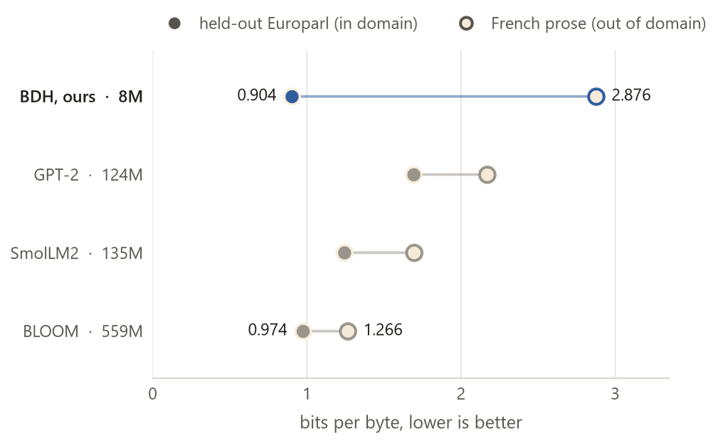
A 131K model you can break in the browser, and an 8M model that translates.
The 131K cipher model
The 8M translation model
What it is. The public MIT bdh.py, unmodified, shrunk to 131,072 parameters: 64 dimensions wide, 2 heads, 256 neurons each, four iterations of one shared operator. Trained by us from scratch in research/train.py.
What it was trained on. One synthetic task. The prompt shows a few symbol to symbol pairs, then asks for one of them back. The mapping is a fresh random bijection in every single example, drawn from 48 source and 48 target bytes. Nothing about the rule can be learned, because it never repeats. The only way to answer is to read the demonstrations back out of the state written during that forward pass.
What it is for. It is the model that runs in the ‘Price’ Page. 263 KB of fp16 weights ship with the page and execute in your browser, within 5.2e-7 of PyTorch on every logit.
Bits per byte on the same text windows; lower is better. The public models are reference points, not controls. Ours, research/compare_quality.py.
12,288 neurons and 7.96M parameters, reading raw bytes.
Out of domain it comes last (2.876). It is a specialist, and the results slide says so.
Notes:
1:00 — The 8M model is weight-tied: its six layers are one operator applied six times. It has two deviations from reference BDH: a learned positional embedding, and no decay term. Always say the out-of-domain result straight after the in-domain one. It is a specialist.
4

Slide 4
The 8M model: six layers are one operator applied six times.
Parameters
7,962,624, and no per-layer weights
Layers
6 , an iteration count of one shared operator, not depth
Width
D = 192 · 4 heads × 3,072 neurons = 12,288
Vocabulary
256 raw bytes, no tokenizer
Data
Europarl v7 en–fr, interleaved source then target
Context
512 bytes
Training
50,000 iterations, AdamW, one A100, roughly 4.5 hrs
Final loss
0.670 val, 0.648 train (nats/byte, held-out Europarl)
The trained 8M model as built and run. Ours, models/README.md.
34.3% of causal attention scores are negative. RoPE, not a decay term, is what makes this model forget.
Notes:
0:50 — 5.13% active is measured over 55,959,552 neuron-token slots, and the training run's own probe independently ends at 5.09%. Only that endpoint is independently reproduced; the curve's shape is the evidence. Weight tying is the part that surprises people: the total is 3·H·D·N + 2·vocab·D, with no n_layer term anywhere. If asked about the merge experiment: it is in the repository, not on a slide — loss goes 0.785 to 1127.6 because our two models were trained independently from scratch, outside the precondition that recipe assumes.
5

Slide 5
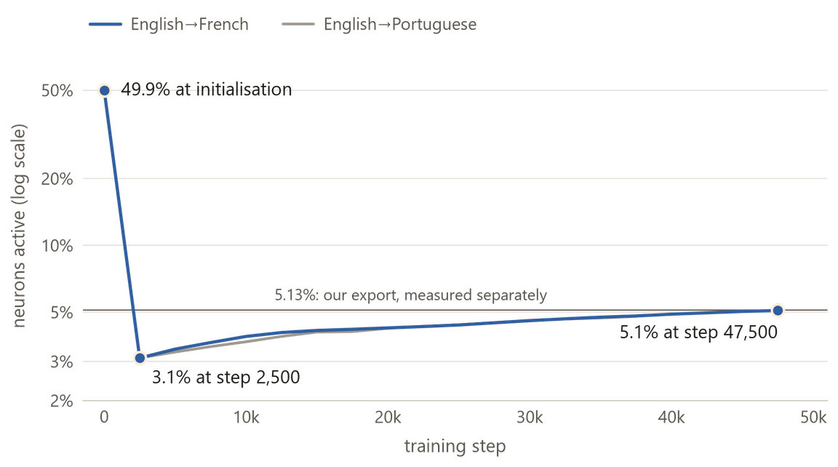
Results: it beats a model 70× its size in domain, and it sparsifies itself.
0.904 bits per byte on held-out Europarl, ahead of BLOOM-560m at 0.974. Final validation loss 0.670.
Sparsity it was never asked for: half the network at initialisation down to 5.1%, and 5.13% active over 55,959,552 neuron-token slots on our full export. Measured against GPT-2 on one shared test, BDH is 4.93% active and GPT-2 86.3%.
The structure is readable. G*, computed from the weights with no data, predicts which neurons stay silent at MCC +0.944.
Share of neurons active during training, from each run's own three-sentence probes. No sparsity term appears in the loss. Ours, research/plot_training.py.
It replicates on an independently trained Portuguese sibling, MCC +0.908.
"The European Parliament voted against this resolution" → "Le Parlement européen a voté contre cette résolution"
Notes:
0:50 — Lead with the sparsity curve: it collapses from half the network to 3.1% in the first 2,500 steps, then settles at 5.1%, and there is no sparsity term anywhere in the loss. Under the same test GPT-2 is 86.3% active. Only the endpoint is independently reproduced (5.13% on the full export); the curve's shape is the evidence. If asked why it beats BLOOM: it is a specialist trained on this distribution — out of domain it comes last, and that is on the limits slide.
6

Slide 6
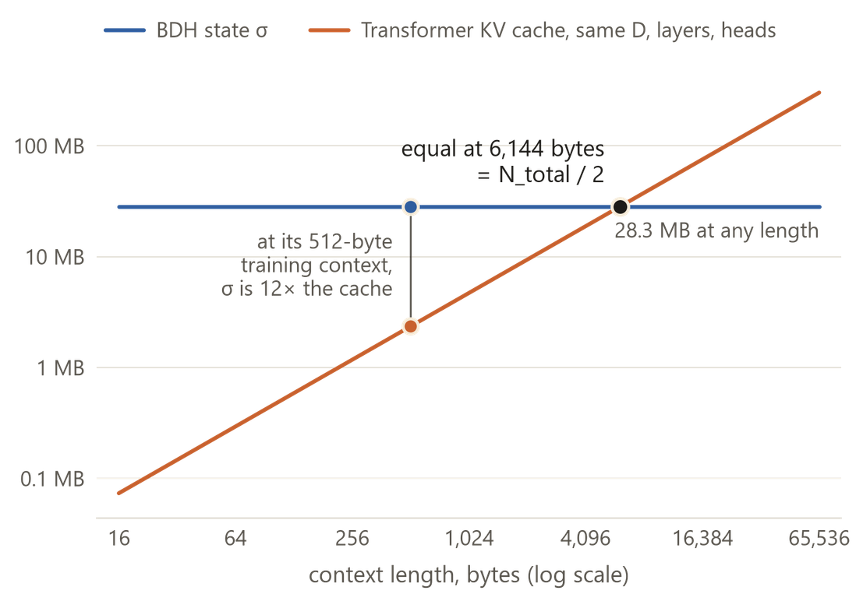
Demonstrations are weights you write at inference time.
Each demonstration is a rank-one write to a fixed-size state: σₜ = σₜ₋₁ + rope(K)ₜ ⊗ Vₜ. The official bdh.py agrees with this form to 2.8 × 10⁻¹⁴.
Only one of BDH's unusual choices buys the fixed state: dropping softmax . Put softmax back and the error is 1.1 × 10²; Q ≠ K or no ReLU leave it at 10⁻⁵.
The claim's second half: capacity depends on how much keys overlap, so the non-negativity that makes BDH readable also makes it forget sooner.
Memory at the 8M model's shape: a Transformer's KV cache grows with context, BDH's state σ stays at 28.3 MB, and they are equal at 6,144 bytes. Ours, research/compare_memory.py.
Notes:
0:50 — At the model's own 512-byte training context, σ is 12× the cache. Constant memory pays off only past 6,144 bytes, which is half the neuron count. If the claim holds, deleting one example from the prompt should change the answer while every weight stays frozen. You will see that in two minutes.
2

Slide 7
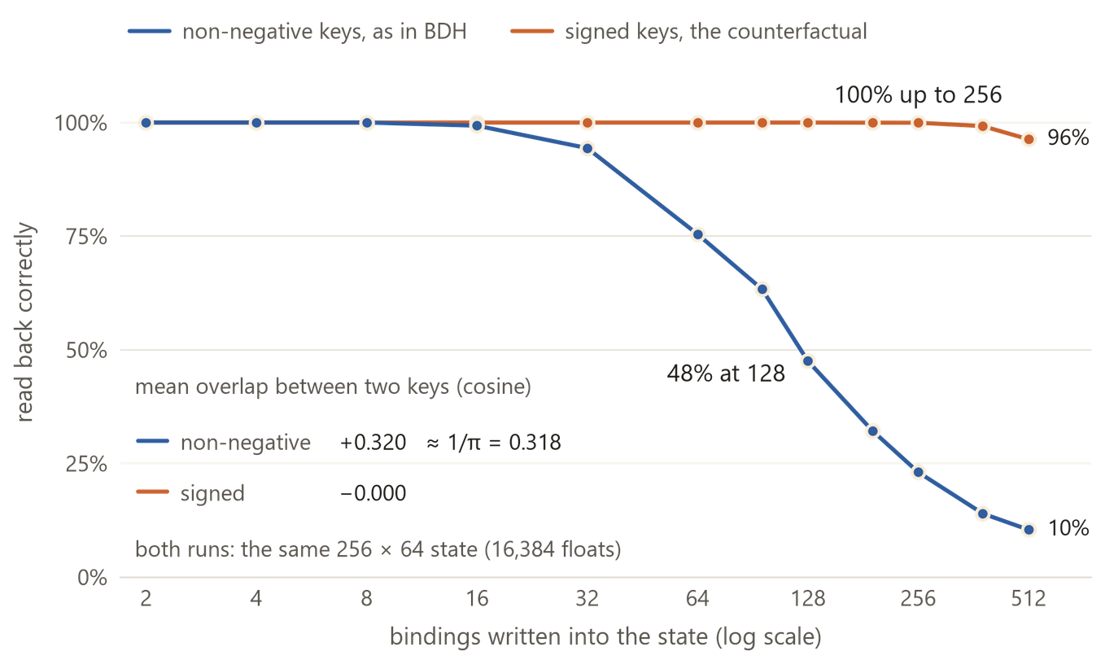
Non-negative keys overlap at 1/π, and that caps what the state can hold.
Reading the figure
The two lines differ only in a ReLU on the keys: non-negative keys hold 48% recall at 128 bindings, signed keys hold 100% to 256.
Their mean overlap is +0.32 , which is 1/π , the rate at which readability costs memory.
The control behind the G* result: a shuffled null scores about 0 against G*'s +0.94.
Bindings written into one fixed 256 × 64 state and read back. The two lines differ only in the ReLU on the keys. Ours, research/sigma_capacity.py.
Notes:
1:10 — Non-negative keys stay at 48% recall with 128 bindings stored. Signed keys in the same state stay at 100% up to 256. Their mean overlap is +0.32, which is 1/π. That is the second half of our claim: BDH's readability costs memory, and we measured the rate.
8

Slide 8
Where BDH sits.
WHAT ADAPTS AT INFERENCE
MEMORY PER EXTRA TOKEN
WHAT YOU CAN INSPECT
CAN YOU RUN IT
TRANSFORMER (DECODER-ONLY)
The context
K and V per layer, growing
Attention maps
Yes
BDH (PUBLIC MIT CODE)
A fixed state σ, one rank-one write per token
Constant
Sparse activations and the synapse graph G*
Yes: we trained and ran it
BDH-CQ
A fixed state, general update U θ
Constant, dimensions undisclosed
Nothing published
No public weights or API
HRM / TRM
The weights, by a backward pass per task
No context state of this kind
Not compared
Cited only
Notes:
Backup — If asked "isn't this just Mamba?": no. The problem statement asks teams not to classify BDH as an SSM in the Mamba sense. BDH-GPU is built from ReLU low-rank transformations with linear attention.
12

Slide 9
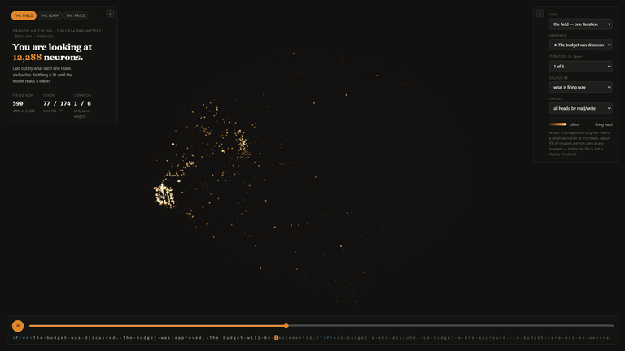
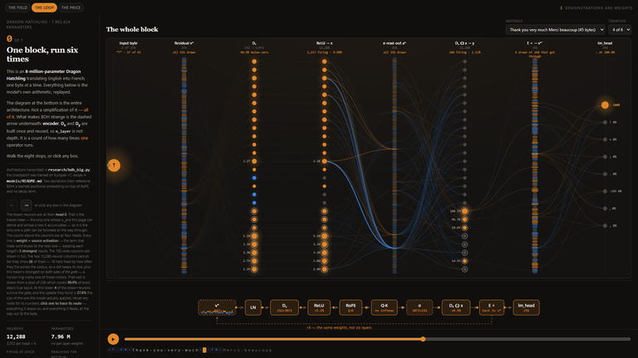
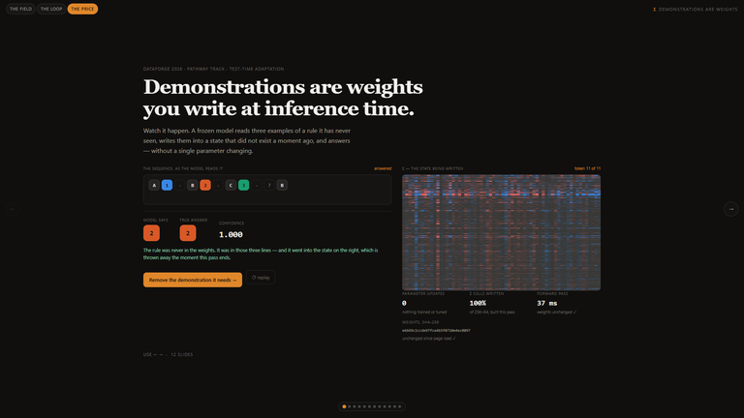
Three pages: see the whole model, open one step, then test the claim.
demonstrations-are-weights.vercel.app
The Field: all 12,288 neurons of the 8M model, drawn live; four views; click any neuron to see its synapses. Live.
The Loop: one iteration in eight stops; every edge is weight × activation. Replayed from our exported tensors.
The Price: the live 131K model — remove one demonstration and the answer flips; then the ablations and the capacity slider. Live.
Live demo
https://demonstrations-are-weights.vercel.app
Notes:
0:20 on the slide, then a 3:30 demo — "Let me show you." Switch to the browser.
7

